Slide 1



Lumio English
LESSON
13
DAYS OF THE WEEK
Monday • Tuesday • Wednesday • Thursday • Friday • Saturday • Sunday
LEVEL 1 · 7 NEW WORDS
Notes:
Welcome the class. Today: Days of the Week. Goal: I can say the days of the week..

Slide 2



Lumio English
Welcome to Lumio English
2 / 27
Hello, little star!
Teacher says:
"Hello! Today we learn 7 new words!"
Notes:
Warm greeting. Set a positive, energetic tone.

Slide 3

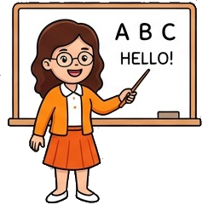
Lumio English
Today's Goals
3 / 27
By the end, you will:
1. Say 7 new words
2. I can say the days of the week.
3. Play games and earn stars
Notes:
Read goals aloud. Keep energy up.

Slide 4
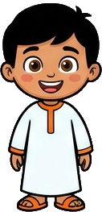

Lumio English
Warm-up • Days of the Week
4 / 27
Let's get ready!
Stand up and stretch!
Say hello to a friend.
Clap your hands three times!
Notes:
2-3 minutes, high energy, physical movement.

Slide 5

Lumio English
Words for Today
5 / 27
7 new words
Monday — الاثنين
Tuesday — الثلاثاء
Wednesday — الأربعاء
Thursday — الخميس
Friday — الجمعة
Saturday — السبت
Sunday — الأحد
Notes:
Preview words quickly. Don't teach yet, just build excitement.

Slide 6

Lumio English
Vocabulary • Monday
6 / 27
Monday
الاثنين
SAY IT
"Today is Monday."
Listen → Repeat ×3
Notes:
Model "Monday" x2, choral repeat x3. Meaning: الاثنين. Sentence: Today is Monday..

Slide 7

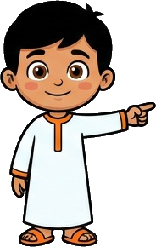
Lumio English
Practice • Monday
7 / 27
Can you say it?
"Today is Monday."
الاثنين
Notes:
Call on a student. Give first-sound hint if needed: "M..."

Slide 8


Lumio English
Vocabulary • Tuesday
8 / 27
Tuesday
الثلاثاء
SAY IT
"Today is Tuesday."
Listen → Repeat ×3
Notes:
Model "Tuesday" x2, choral repeat x3. Meaning: الثلاثاء. Sentence: Today is Tuesday..

Slide 9
Lumio English
Practice • Tuesday
9 / 27
Can you say it?
"Today is Tuesday."
الثلاثاء
Notes:
Call on a student. Give first-sound hint if needed: "T..."

Slide 10


Lumio English
Vocabulary • Wednesday
10 / 27
Wednesday
الأربعاء
SAY IT
"Today is Wednesday."
Listen → Repeat ×3
Notes:
Model "Wednesday" x2, choral repeat x3. Meaning: الأربعاء. Sentence: Today is Wednesday..

Slide 11
Lumio English
Practice • Wednesday
11 / 27
Can you say it?
"Today is Wednesday."
الأربعاء
Notes:
Call on a student. Give first-sound hint if needed: "W..."

Slide 12

Lumio English
Vocabulary • Thursday
12 / 27
Thursday
الخميس
SAY IT
"Today is Thursday."
Listen → Repeat ×3
Notes:
Model "Thursday" x2, choral repeat x3. Meaning: الخميس. Sentence: Today is Thursday..

Slide 13
Lumio English
Practice • Thursday
13 / 27
Can you say it?
"Today is Thursday."
الخميس
Notes:
Call on a student. Give first-sound hint if needed: "T..."

Slide 14

Lumio English
Vocabulary • Friday
14 / 27
Friday
الجمعة
SAY IT
"Today is Friday."
Listen → Repeat ×3
Notes:
Model "Friday" x2, choral repeat x3. Meaning: الجمعة. Sentence: Today is Friday..

Slide 15
Lumio English
Practice • Friday
15 / 27
Can you say it?
"Today is Friday."
الجمعة
Notes:
Call on a student. Give first-sound hint if needed: "F..."

Slide 16

Lumio English
Vocabulary • Saturday
16 / 27
Saturday
السبت
SAY IT
"Today is Saturday."
Listen → Repeat ×3
Notes:
Model "Saturday" x2, choral repeat x3. Meaning: السبت. Sentence: Today is Saturday..

Slide 17
Lumio English
Practice • Saturday
17 / 27
Can you say it?
"Today is Saturday."
السبت
Notes:
Call on a student. Give first-sound hint if needed: "S..."

Slide 18

Lumio English
Vocabulary • Sunday
18 / 27
Sunday
الأحد
SAY IT
"Today is Sunday."
Listen → Repeat ×3
Notes:
Model "Sunday" x2, choral repeat x3. Meaning: الأحد. Sentence: Today is Sunday..

Slide 19
Lumio English
Practice • Sunday
19 / 27
Can you say it?
"Today is Sunday."
الأحد
Notes:
Call on a student. Give first-sound hint if needed: "S..."

Slide 20

Lumio English
Listen and Repeat
20 / 27
My turn, your turn!
1. Monday
2. Tuesday
3. Wednesday
4. Thursday
5. Friday
6. Saturday
7. Sunday
Notes:
Point and say each word, students repeat.

Slide 21
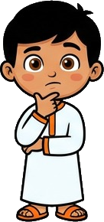
Lumio English
Your Turn • Round 1 of 3
21 / 27
What is this?
Notes:
Call a student by name. Answer: Monday (الاثنين). Hint if needed: "M..."

Slide 22
Lumio English
Your Turn • Round 2 of 3
22 / 27
What is this?
Notes:
Call a student by name. Answer: Tuesday (الثلاثاء). Hint if needed: "T..."

Slide 23
Lumio English
Your Turn • Round 3 of 3
23 / 27
What is this?
Notes:
Call a student by name. Answer: Wednesday (الأربعاء). Hint if needed: "W..."

Slide 24

Lumio English
Game • Quiz 1 of 2
24 / 27
Which word means "السبت"?
A
B
C
Saturday
Thursday
Monday
Notes:
Answer: Saturday. Count down 5-4-3-2-1 for excitement.

Slide 25
Lumio English
Game • Quiz 2 of 2
25 / 27
Which word means "الأحد"?
A
B
C
Saturday
Wednesday
Sunday
Notes:
Answer: Sunday. Count down 5-4-3-2-1 for excitement.

Slide 26


Lumio English
Reward Time
26 / 27
Great job!
★ ★ ★ ★ ★
You earned 5 stars!
Play Lesson 13 online to keep your streak!
Notes:
Celebrate! Praise students by name if time allows.

Slide 27
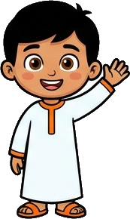
Lumio English
Homework & Goodbye
27 / 27
See you next time!
1. Play Lesson 13 on Lumio English
2. Say each word to your family
3. Earn your three stars!
Notes:
Assign homework. Warm goodbye.

